Slide 1
INTRODUCTION TO
ALGORITHMS
FOURTH EDITION

Slide 2
LECTURE NOTES FOR CHAPTER 9
Medians and Order Statistics

Slide 3
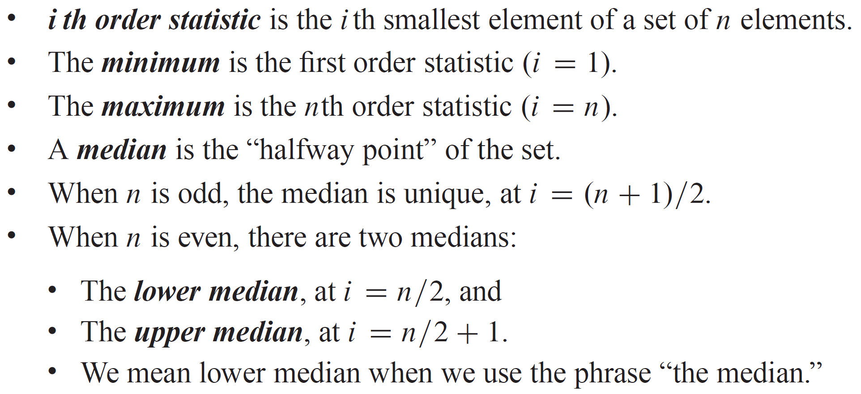
CHAPTER 9 OVERVIEW

Slide 4
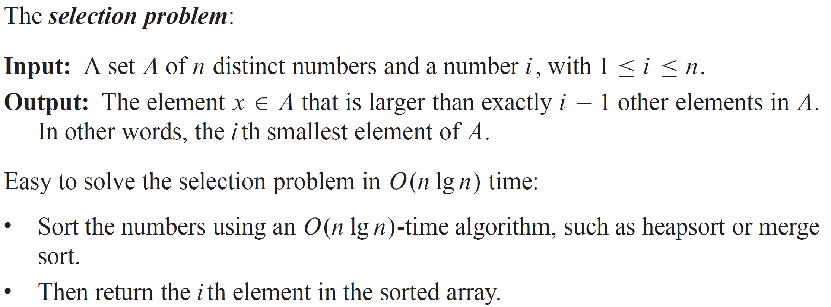
CHAPTER 9 OVERVIEW

Slide 5
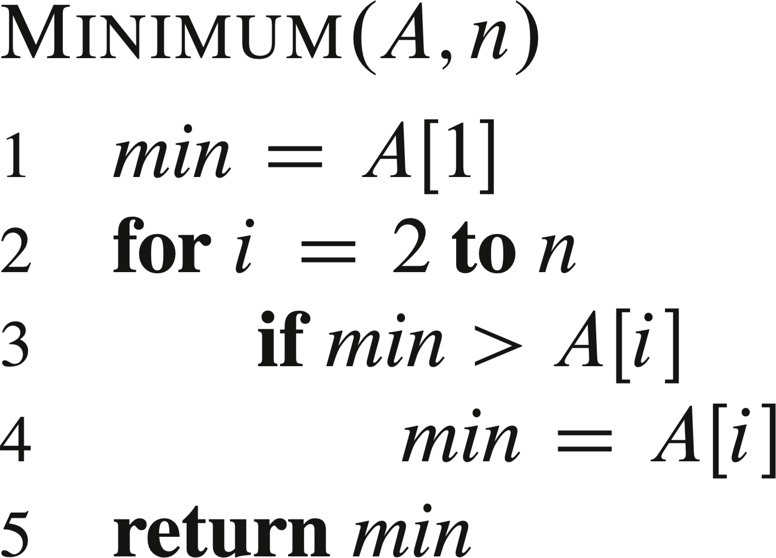
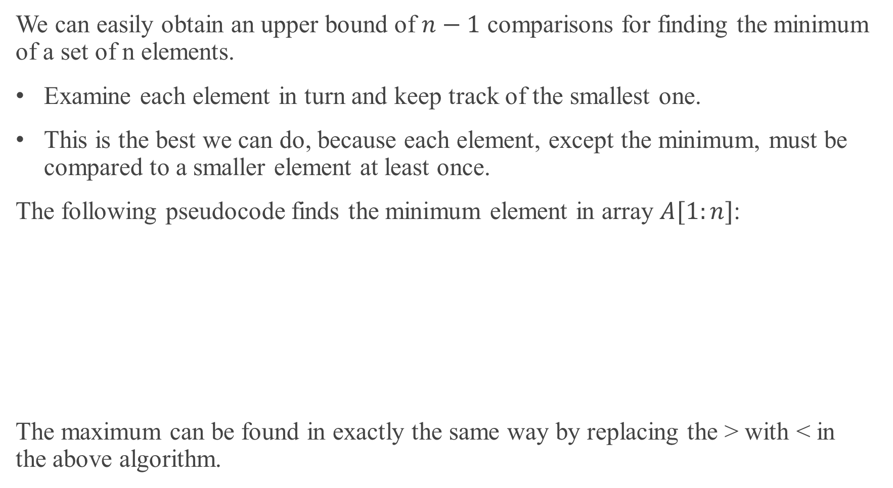
MINIMUM AND MAXIMUM
We can easily obtain an upper bound of $n−1$ comparisons for finding the minimum of a set of n elements.
Examine each element in turn and keep track of the smallest one.
This is the best we can do, because each element, except the minimum, must be compared to a smaller element at least once.
The following pseudocode finds the minimum element in array $A[1:n]$:
The maximum can be found in exactly the same way by replacing the > with < in the above algorithm.

Slide 6
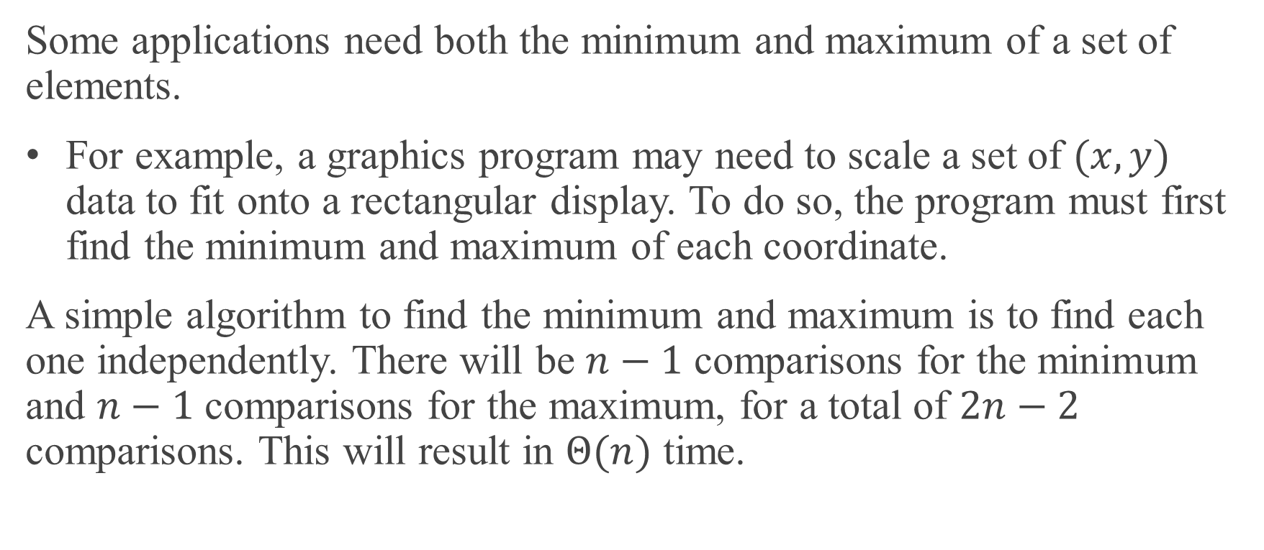
SIMULTANEOUS MINIMUM AND MAXIMUM
Some applications need both the minimum and maximum of a set of elements.
For example, a graphics program may need to scale a set of $(x, y)$ data to fit onto a rectangular display. To do so, the program must first find the minimum and maximum of each coordinate.
A simple algorithm to find the minimum and maximum is to find each one independently. There will be $n−1$ comparisons for the minimum and $n−1$ comparisons for the maximum, for a total of $2n−2$ comparisons. This will result in $Θ(n)$ time.

Slide 7
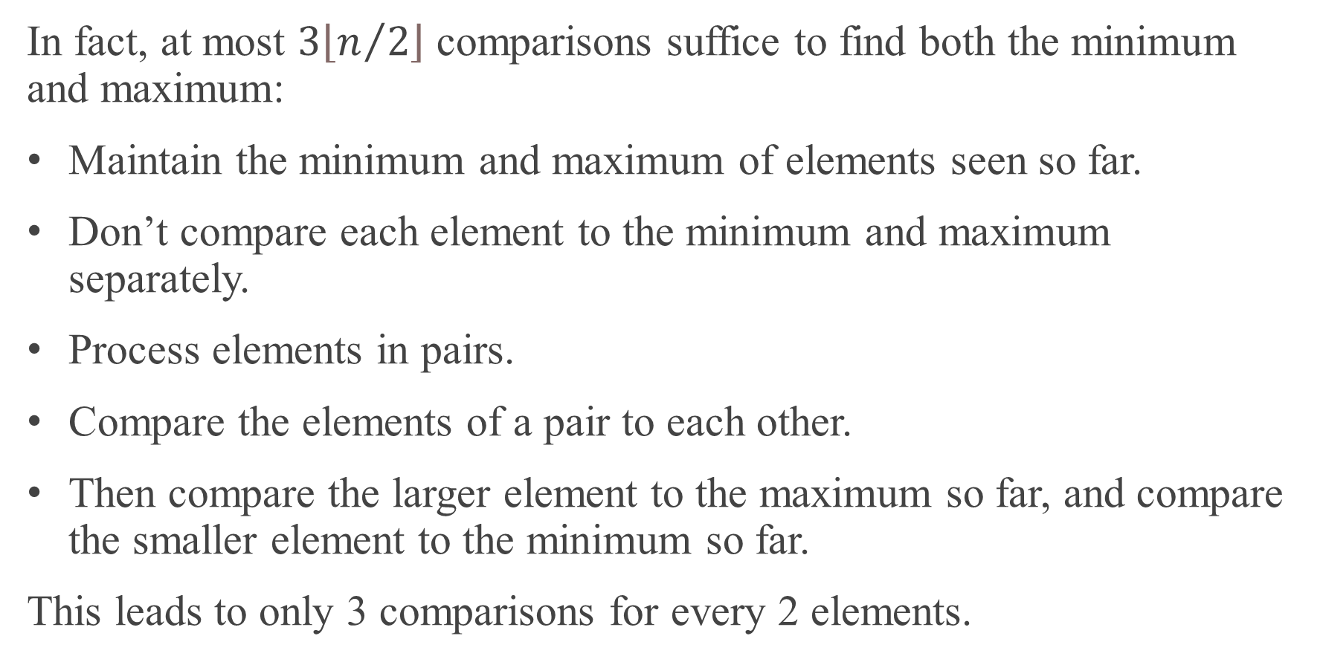
SIMULTANEOUS MINIMUM AND MAXIMUM (continued)
In fact, at most $3\left\lfloor n/2\right\rfloor$ comparisons suffice to find both the minimum and maximum:
Maintain the minimum and maximum of elements seen so far.
Don’t compare each element to the minimum and maximum separately.
Process elements in pairs.
Compare the elements of a pair to each other.
Then compare the larger element to the maximum so far, and compare the smaller element to the minimum so far.
This leads to only 3 comparisons for every 2 elements.

Slide 8
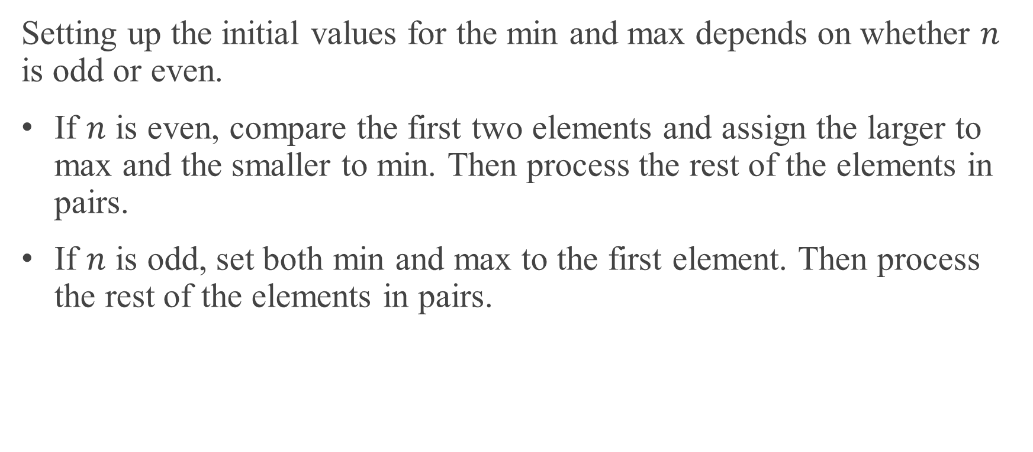
SIMULTANEOUS MINIMUM AND MAXIMUM (continued)
Setting up the initial values for the min and max depends on whether $n$ is odd or even.
If $n$ is even, compare the first two elements and assign the larger to max and the smaller to min. Then process the rest of the elements in pairs.
If $n$ is odd, set both min and max to the first element. Then process the rest of the elements in pairs.

Slide 9
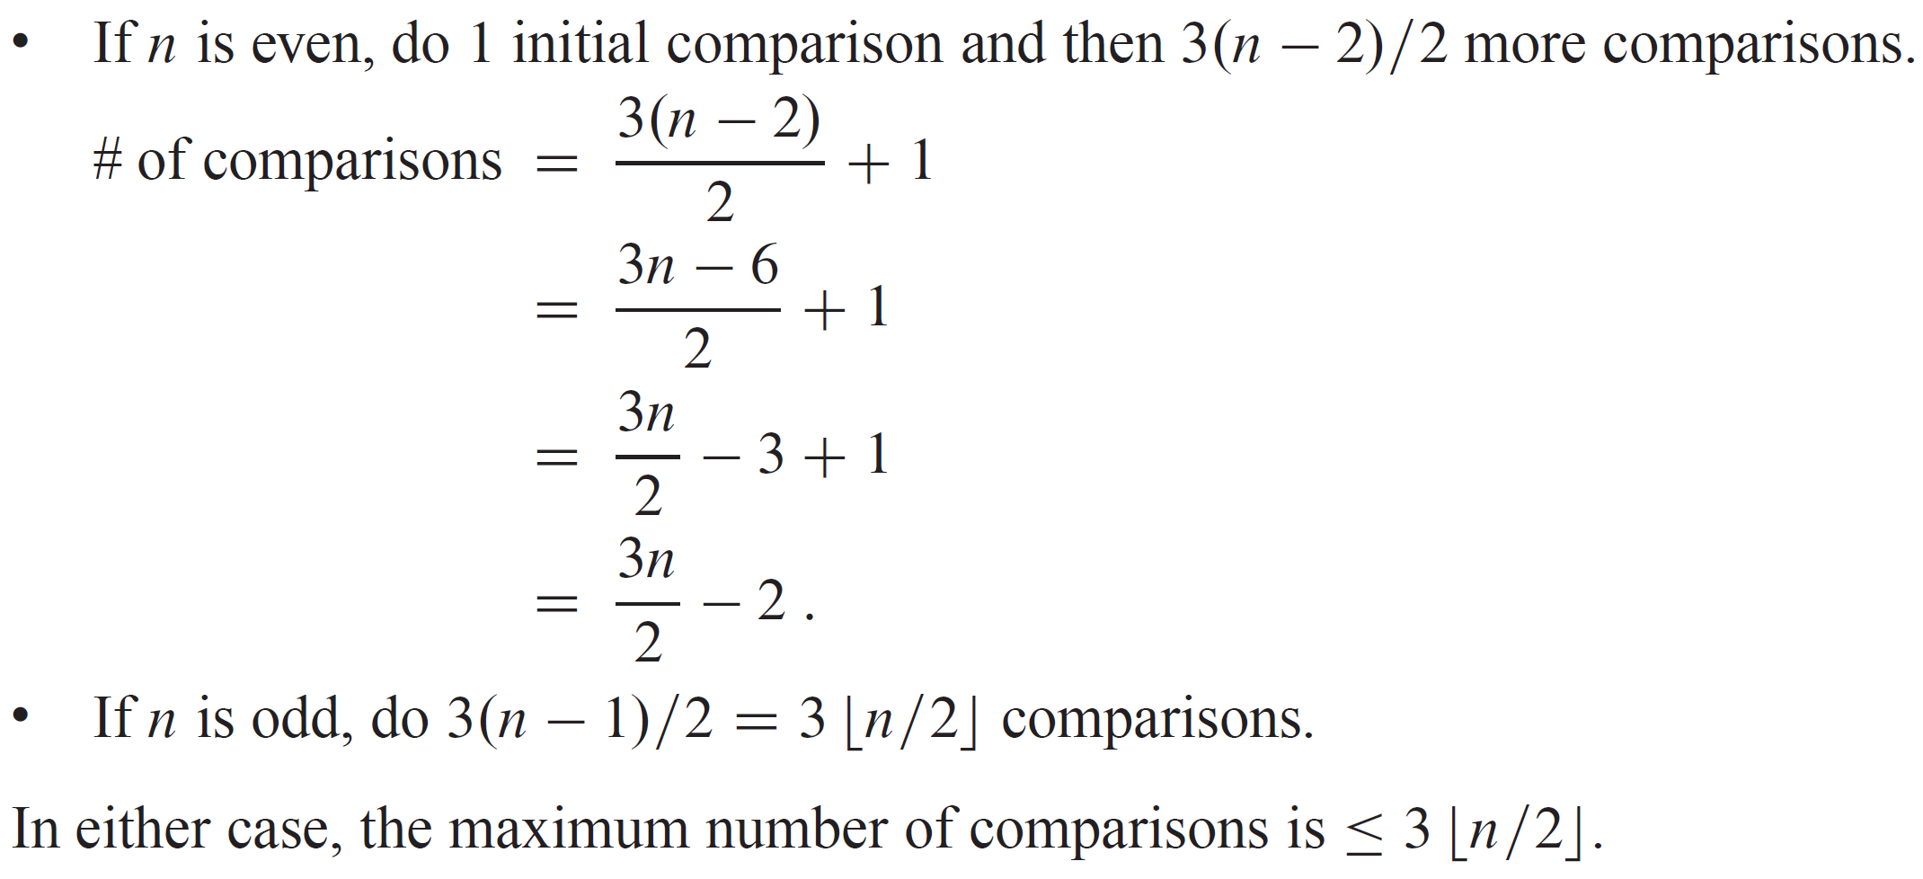
ANALYSIS OF THE TOTAL NUMBER OF COMPARISONS

Slide 10
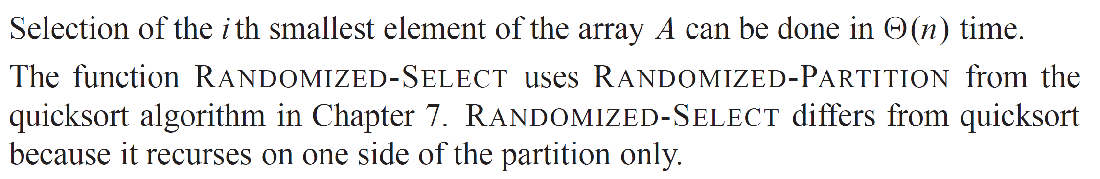
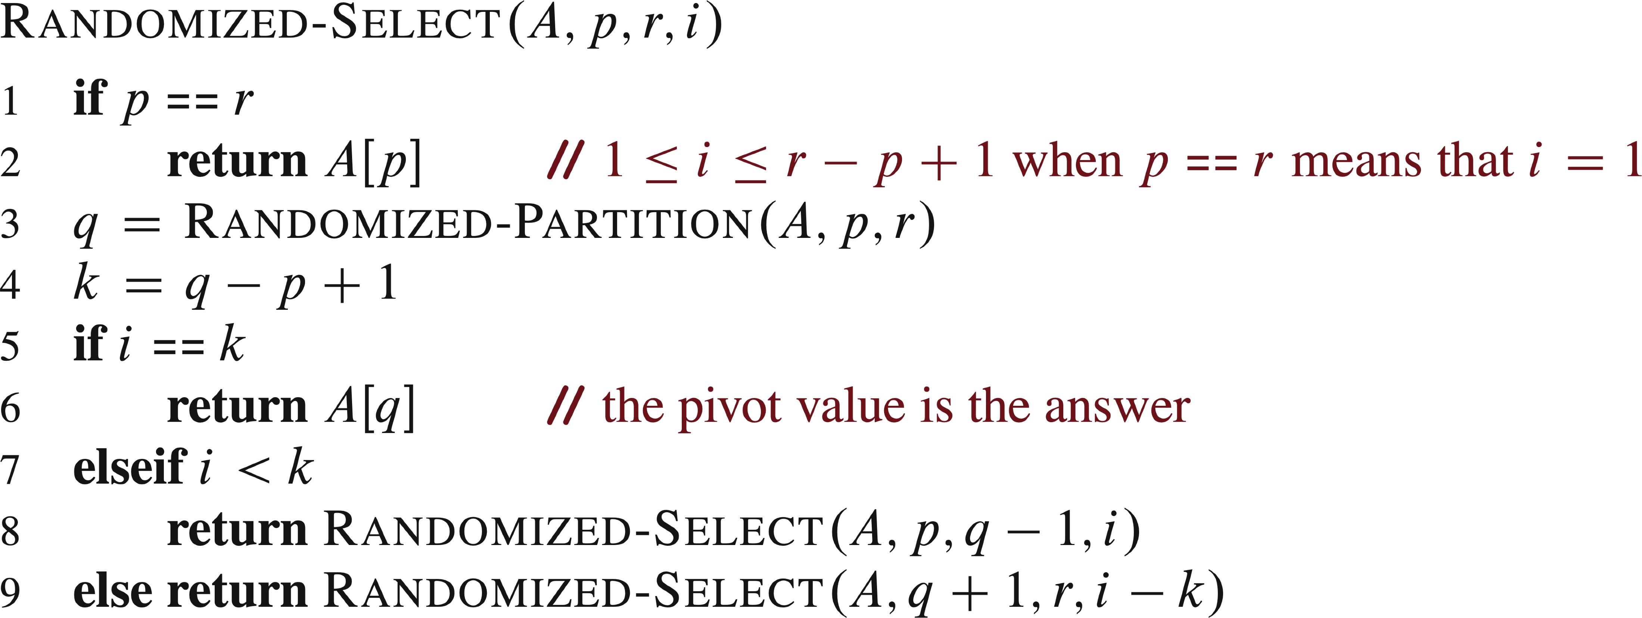
SELECTION IN EXPECTED LINEAR TIME

Slide 11
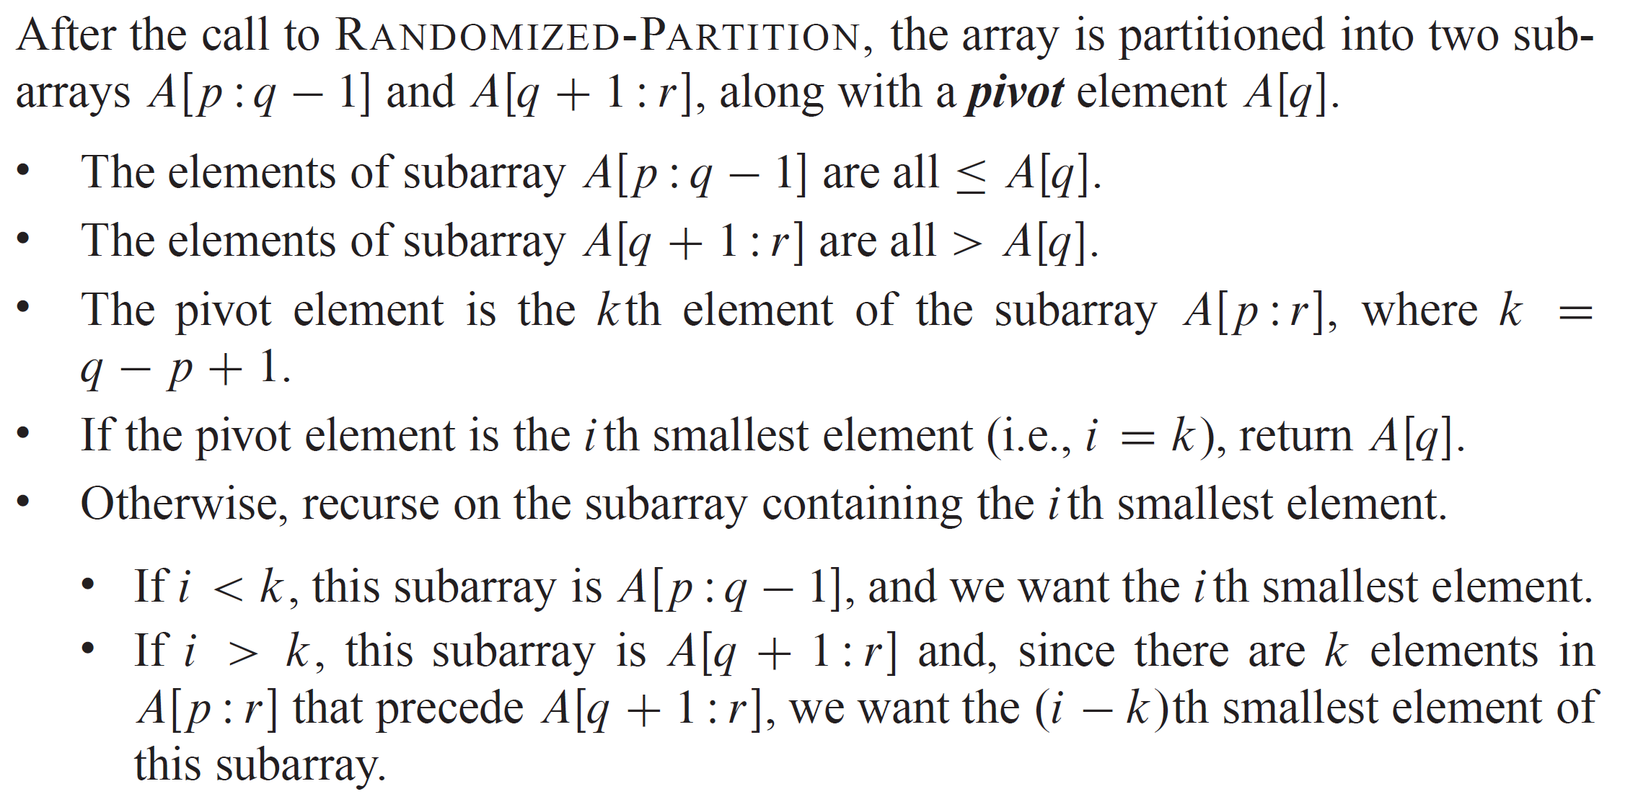
SELECTION IN EXPECTED LINEAR TIME (continued)

Slide 12
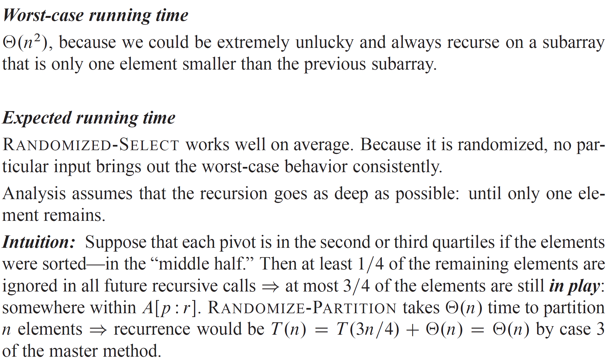
ANALYSIS

Slide 13
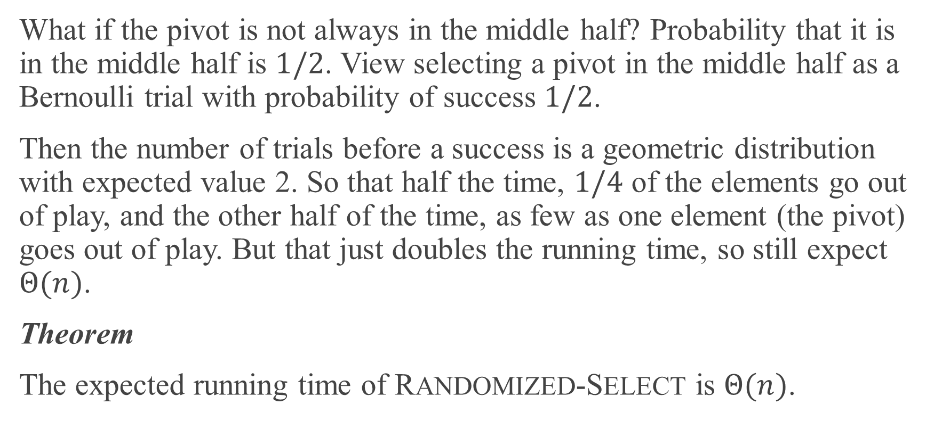
ANALYSIS (continued)
What if the pivot is not always in the middle half? Probability that it is in the middle half is $1/2$. View selecting a pivot in the middle half as a Bernoulli trial with probability of success $1/2$.
Then the number of trials before a success is a geometric distribution with expected value 2. So that half the time, $1/4$ of the elements go out of play, and the other half of the time, as few as one element (the pivot) goes out of play. But that just doubles the running time, so still expect $Θ(n)$.
Theorem
The expected running time of RANDOMIZED-SELECT is $Θ(n)$.

Slide 14
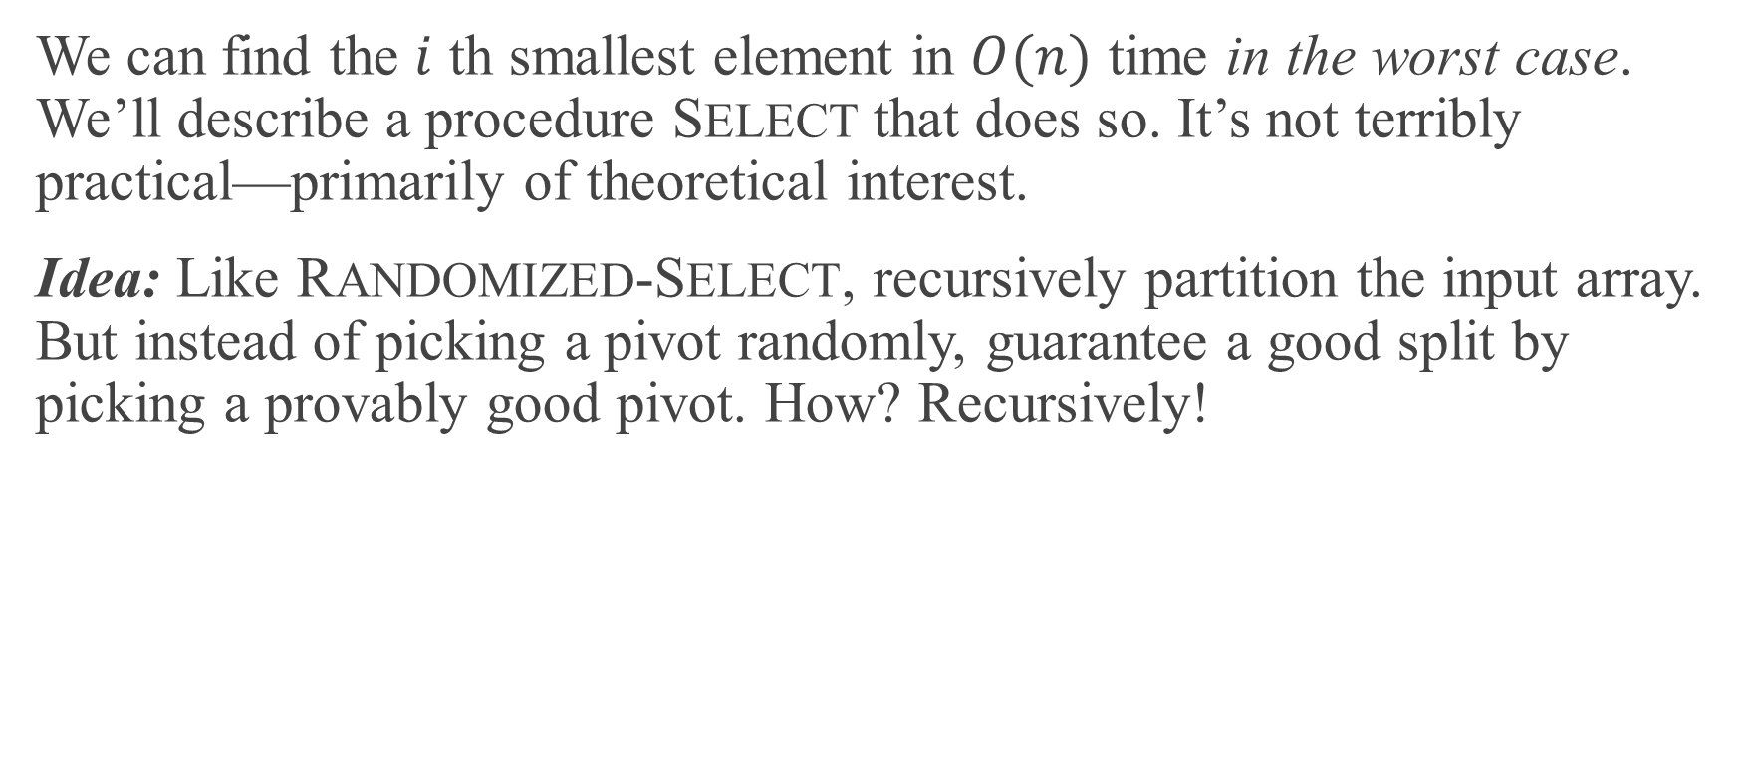
SELECTION IN WORST-CASE LINEAR TIME
We can find the $i$ th smallest element in $O(n)$ time in the worst case. We’ll describe a procedure SELECT that does so. It’s not terribly practical—primarily of theoretical interest.
Idea: Like RANDOMIZED-SELECT, recursively partition the input array. But instead of picking a pivot randomly, guarantee a good split by picking a provably good pivot. How? Recursively!

Slide 15
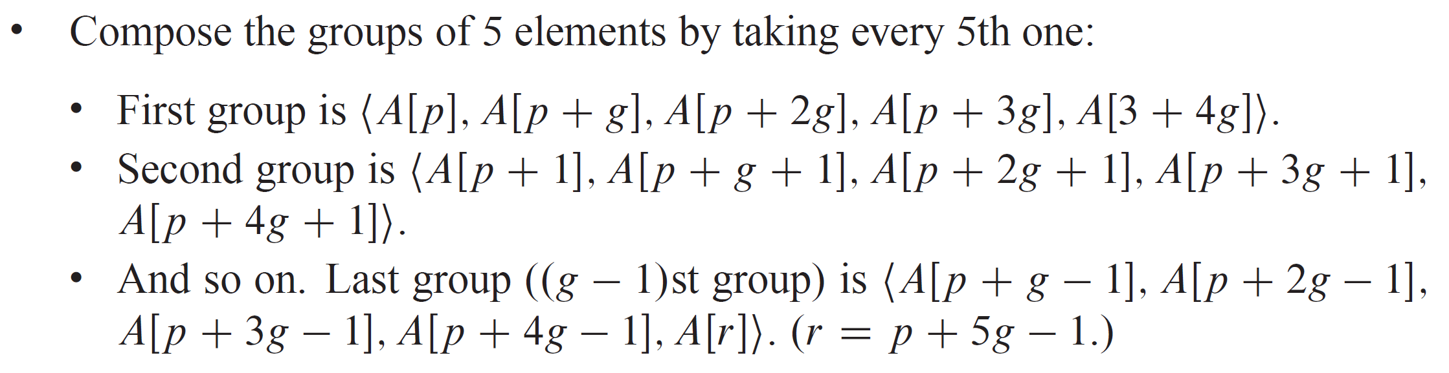
SELECTION IN WORST-CASE LINEAR TIME (continued)

Slide 16
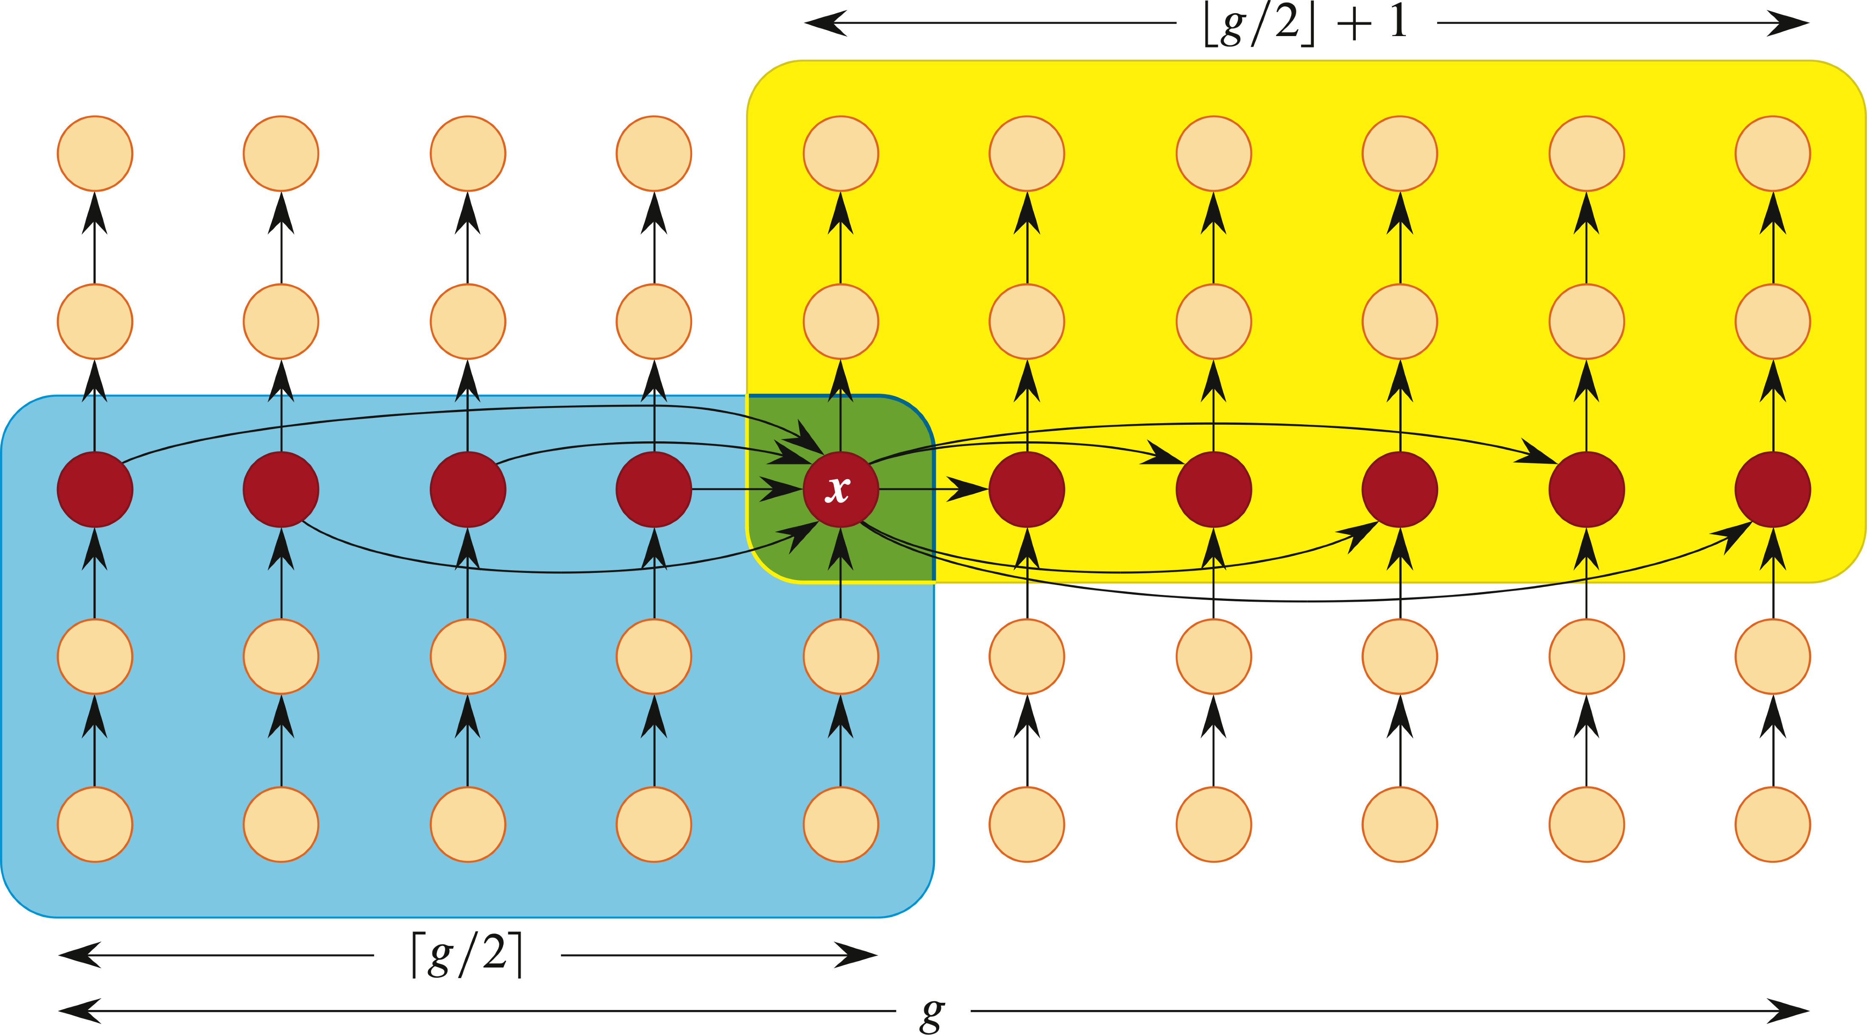
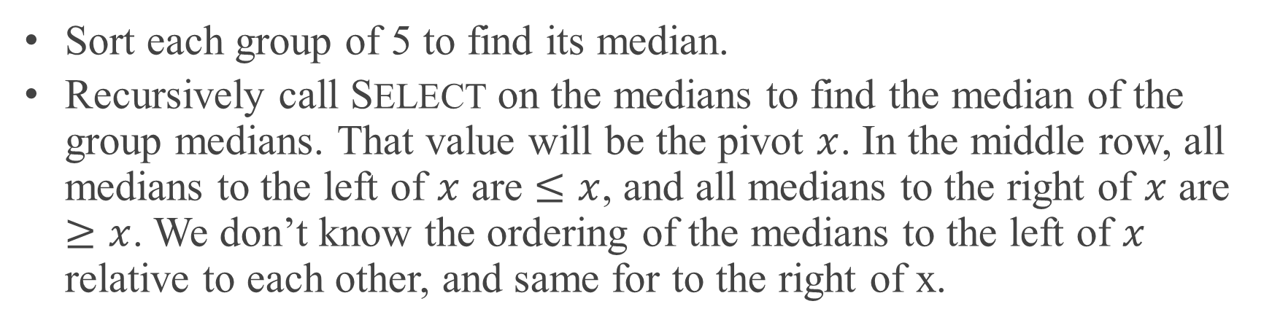
SELECTION IN WORST-CASE LINEAR TIME (continued)
[Each column is a group of 5 elements. Arrows point from smaller elements to larger elements. The group medians are the middle fifth of the array, shown in the figure with heavy outlines in the middle row.]
Sort each group of 5 to find its median.
Recursively call SELECT on the medians to find the median of the group medians. That value will be the pivot $x$. In the middle row, all medians to the left of $x$ are $≤x$, and all medians to the right of $x$ are $≥x$. We don’t know the ordering of the medians to the left of $x$ relative to each other, and same for to the right of x.

Slide 17
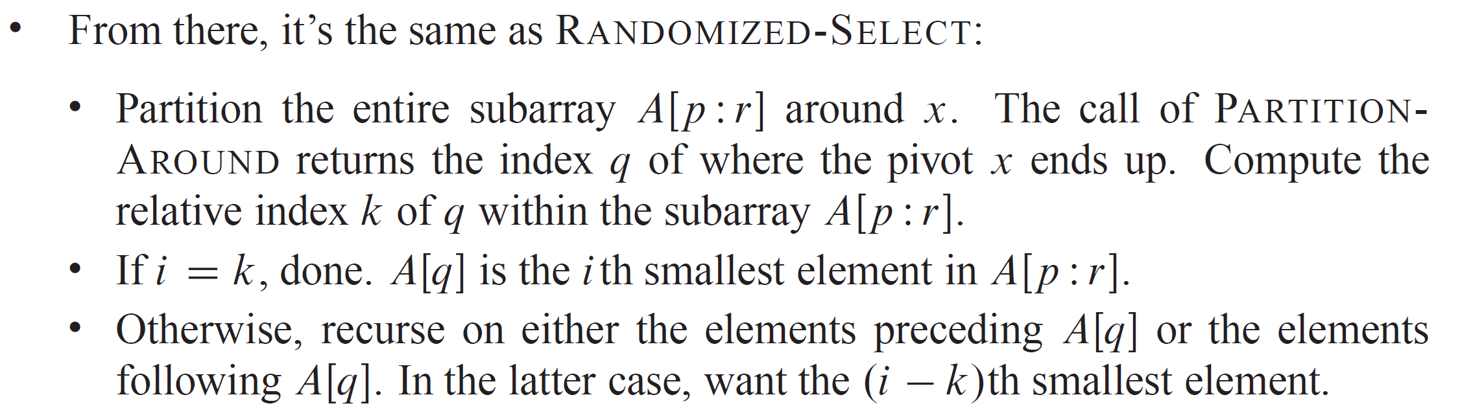
SELECTION IN WORST-CASE LINEAR TIME (continued)

Slide 18
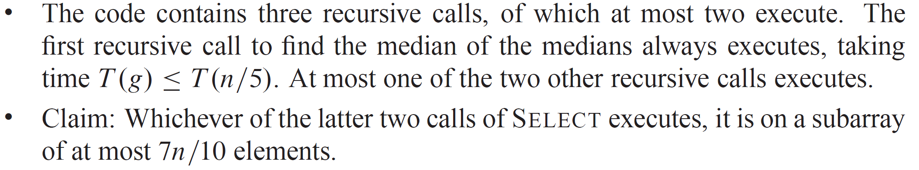
ANALYSIS

Slide 19
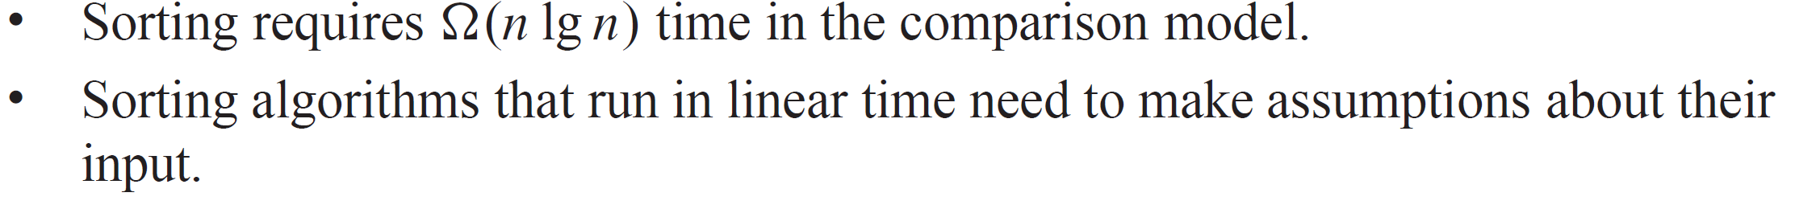
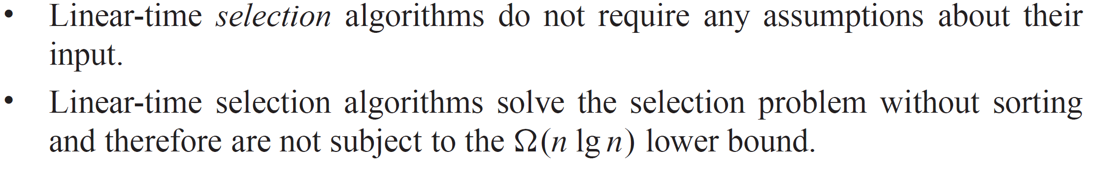
ANALYSIS (continued)

